Slide 1
Student Voices on Poverty and the SDGs: Is poverty a legitimate management topic?
Geri Mason, PhD
Seattle Pacific University
Seattle, WA, USA
Al Rosenbloom, PhD (Emeritus)
Dominican University
River Forest, IL, USA

Slide 2
Presentation Overview
Overview of Integrating Poverty in Management Education
The Student Voice
Survey Methodology
Survey Findings
Survey Implications

Slide 3


Issue of Poverty in Management Education
Is gaining acceptance
  Rise in corporate social responsibility
  Rise in responsible management

Slide 4
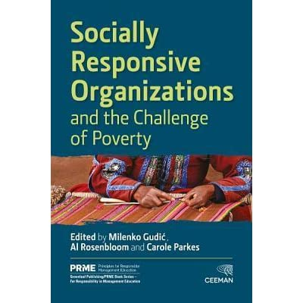


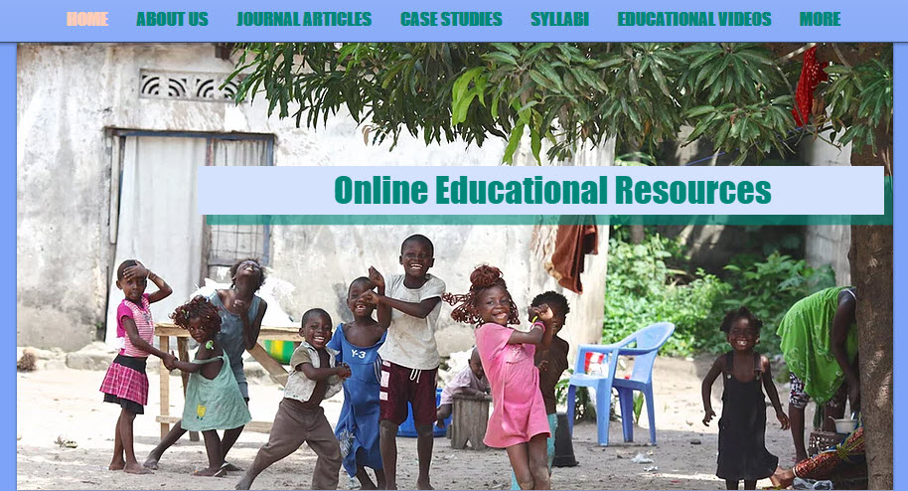
Issue of Poverty in Management Education
Increased scholarship by business and management faculty
  Global research on faculty acceptance
  Development of classroom pedagogies
    Books
    Scholarly articles
    Online Resources

Slide 5
Student Voice: It’s Importance
While students may not be well versed in pedagogy, they innately know many critical things about how they learn and what supports the process. This information, when heard, can fuel critical discussion on effective teaching and learning.
          Erik Blair and Keisha Valdez Noel: Improving higher education practice through student evaluation systems: is the student voice being heard?

Slide 6
The Student Voice
Course evaluations
Program development
Individual topics of interest
Mainly local and national but not global

Slide 7
Survey Rationale
No survey to date:
  Captured student perception data on poverty as a legitimate topic in management education
  Asked students to assess stakeholder responsibility for poverty reduction
  Did so on a global scale

Slide 8


In Passing

Slide 9
Survey Methods
Global Survey sponsored by the PRME Anti-Poverty Working Group
  Given IRB Approval, Dominican University
Survey posted on surveymonkey.com (May 2018- January 2019)
Survey translated into 11 languages
  Arabic, Bulgarian, Chinese, English, French, German, Polish, Portuguese, Russia, Serbo-Croatian, Spanish
Had both quantitative and qualitative questions
  Quantitative questions: 5 point Likert scale
Total responses = 1,385

Slide 10
Survey Sections (1)
Exploration of the Sustainable Development Goals
  Familiarity with and class assignments related to global platforms
    For example, UN Global Compact, PRME, Sulitest, aim2flourish
  Extent of opportunity to study each SDG
  Desire to spend more time studying each SDG

Slide 11
Survey Sections (2)
In-depth exploration of SDG 1: No Poverty
  Poverty as a legitimate topic of study
  Reason for interest
    For example, faculty instructor made the case, guest speaker interest, class assignment, fit within institutional culture
  Stakeholder responsibility
    Student, graduate, citizen (member of society), business’s role, nonprofit, government
  Open ended questions
    Description of significant learning opportunity
    Suggestion for greater learning opportunity
    Identification of barriers/challenges to learning

Slide 12
Respondent Demographics
Female respondents: n=636 v. male respondents: n=368;
Top five areas of study:
  Management (n=436), economics (n=307), marketing (n=278), administration (n=234) and finance (n=213)
Level of study:
  Bachelors (n=507); Masters (n=262), PhD (n=171)
Top five countries where respondents are studying:
  United States (n=225); Poland (n=148); Russia (n=127); Montenegro (n=78), and Latvia (n=75)

Slide 13
What Did We Find?
Is poverty a legitimate topic of study?
  Students say “yes”
  Mean score 3.16 (scale: 1-4, 1=not legitimate at all, 4 = very legitimate)

Slide 14
Poverty as a legitimate management topic
 | Poverty is a Legitimate Topic
PRME school | 0.0148
 | (0.754)
PRME Exposure | 0.0829
 | (0.221)
SDGs Exposure | 0.1235**
 | (0.013)
Student Voice | 0.4132***
 | (0.000)
Faculty Voice | 0.0548
 | (0.355)
Employer Voice | 0.1887***
 | (0.000)
University Voice | 0.2153***
 | (0.002)
What makes students likely to report that poverty a legitimate topic of study (4-5 score)?
  Controls include:
    Demographics
    Class assignments
    Country of study
    Majors

Slide 15
Poverty as a legitimate management topic
 | Poverty is a Legit. Topic
Accounting | -0.0591
 | (0.323)
Business Admin | -0.1007**
 | (0.040)
Economics | 0.0274
 | (0.547)
Ethics | 0.0929
 | (0.280)
Finance | -0.0944*
 | (0.092)
Human Resources | -0.0025
 | (0.960)
Information Systems | -0.0713
 | (0.309)
Management | 0.0711*
 | (0.092)
Marketing | -0.0529
 | (0.232)
Law | 0.2334***
 | (0.008)
Operations | 0.0229
 | (0.784)
Quantitative Methods | 0.1143
 | (0.151)
Strategy | 0.1371**
 | (0.021)
Majors less likely to find poverty a legitimate topic of study:
  Business Administration
  Finance
Majors more likely to find poverty a legitimate topic of study:
  Management
  Law
  Strategy

Slide 16
Who is responsible for poverty alleviation?
Entity | % ‘very’ or ‘extremely’
The government | 72%
International organizations | 65%
Business | 59%
NGOs | 55%
Me, as a business professional | 51%
Society members | 49%
Me, as a volunteer | 44%
Me, as a student | 34%

Slide 17
Am I responsible for poverty alleviation?
Only 34% of the sample viewed themselves, as students, responsible:
  Student voice
  Faculty voice
  University voice
51% of the sample viewed themselves, as businesspeople, responsible:
  Student voice
  Faculty voice
  University voice
 | Student Responsibility | Businessperson Responsibility
PRME school | 0.0085 | -0.0062
 | (0.760) | (0.836)
PRME | 0.0218 | 0.0079
Exposure | (0.583) | (0.855)
SDGs | -0.0293 | 0.0467
Exposure | (0.315) | (0.141)
Student Voice | 0.1156*** | 0.2346***
 | (0.001) | (0.000)
Faculty Voice | 0.1355*** | 0.1084***
 | (0.000) | (0.004)
Employer Voice | 0.0128 | 0.0592
 | (0.731) | (0.143)
University Voice | 0.1275*** | 0.0998**
 | (0.002) | (0.024)

Slide 18
Study Insights
The #1 reason to incorporate poverty into
business education is the students’ personal confidence
in the importance of the topic.

Slide 19
Study Insights
There is plenty of opportunity for all business disciplines, including quantitative ones, to integrate poverty into course study

Slide 20
Study Insights
Students report low exposure to the SDGs and class assignments
  Let’s put this in the curriculum!
Faculty voice is not influential in students’ determination of whether or not poverty is a legitimate topic
  Faculty: use your voices! Add assignments, discussions, readings…talk about the centrality of poverty (threshold concept)
Students do not look to employers to assign responsibility for poverty alleviation to them
  Let’s teach students about Responsible Management – so that they expect to be responsible for poverty alleviation especially as businesspeople

Slide 21
Thanks!
  Questions?

